Slide 1
AI-Powered YouTube Transcript Chatbot
Capstone Project
This presentation outlines the architecture, key components, and data flow of a Python-based chatbot designed to extract, enhance, summarize, and optionally translate YouTube video transcripts.
Gavaskar Ezhilarasan
IIT – Patna
Artificial Intelligence and Machine Learning Program July 2025
Submitted as part of capstone project titled “Create a simple chatbot using python to understand how NLP libraries work”

Slide 2


Purpose and Core Objectives
Transcript Extraction
Automate the retrieval of video transcripts from YouTube using specialized APIs.
Text Enhancement
Improve raw transcripts by adding punctuation and proper capitalization.
Abstractive Summarization
Generate concise and coherent summaries of video content using AI models.
Optional Translation
Provide translations of summaries into various Indian languages.
The primary purpose is to enhance accessibility and comprehension of YouTube video content, addressing key user needs by making information more universally available.
2

Slide 3



Vision: Accessibility & Comprehension
Enhanced Accessibility
Improved Comprehension
Multilingual Support
Makes YouTube content available to broader audiences
Summarization reduces cognitive load for complex topics
Breaks language barriers through translation features
Beneficial for users who prefer reading over watching videos
Enhances raw transcripts with proper formatting
Makes content accessible to non- English speakers
Provides quick access to key information from long-form content
Distills essential concepts for faster understanding
Fosters global knowledge sharing across languages
Our vision is to democratize access to video knowledge by making content more digestible and universally accessible.
3

Slide 4





Key Components Breakdown
Input Handler
Validates YouTube URLs and extracts the unique video ID, serving as the entry point for content processing.
Transcript Retriever
Utilizes youtube_transcript_api to efficiently fetch subtitles or closed captions associated with YouTube videos.
Enhancement Module
Employs deepmultilingualpunctuation to add correct punctuation and capitalization to raw transcripts.
Summarizer
Leverages Hugging Face's t5-small model to generate high-quality abstractive summaries of video content.
Sentence Splitter
Utilizes spaCy for accurate segmentation of summaries into individual sentences, improving readability.
Translation Handler
Integrates deep-translator to provide translation of summaries into various Indian languages.
Display Formatter
Responsible for structuring and presenting the final summary and translation in a clean, user-friendly format within the Command Line Interface (CLI).
Each component plays a vital role in the processing pipeline, from URL validation to final output formatting.
4

Slide 5
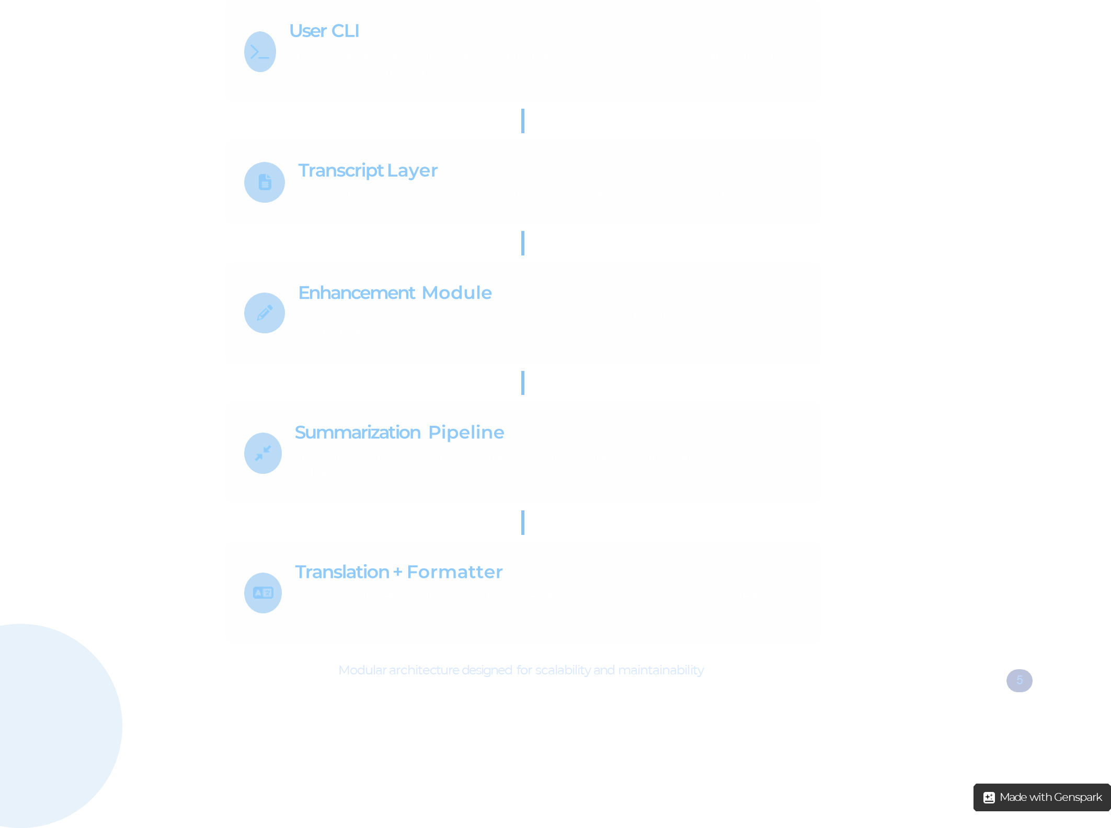
System Architecture Overview
z
5

Slide 6
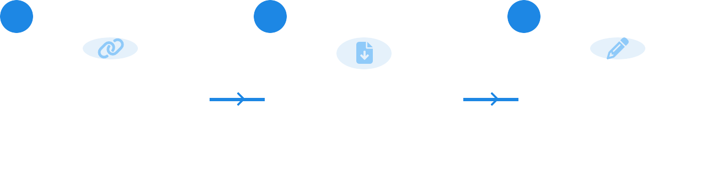

Comprehensive Data Flow
1
2
3
User Input
The process begins with the user providing a YouTube video URL to the CLI
Enhancement
Raw transcript is enhanced with proper punctuation and capitalization
Transcript Fetch
The system extracts the video ID and retrieves the transcript
6
5
4
Output Display
Translation
Summarization
Final formatted summary is presented to the user in the CLI
If requested, summary is translated into the target language
Enhanced text is fed to t5-small for abstractive summarization
The data flow represents a precise sequence of operations from raw YouTube content to an insightful, formatted summary
6

Slide 7






Technology Stack
Python as the Core
Python was chosen for its extensive libraries, ease of development, and strong community support, making it ideal for AI and NLP applications.
Rapid Prototyping Modularity Rich Ecosystem
NLP Powerhouses
spaCy transformers (t5-small)
DeepMultilingualPunctuation
deep-translator
textwrap
re
External APIs
YouTubeTranscriptApi
GoogleTranslator
Hugging Face API
This technology stack ensures high performance, flexibility, and access to a rich ecosystem of tools for natural language processing and data handling.
7

Slide 8

External Interfaces & Technology Details
API Integration Benefits
Cloud Resource Utilization
Streamlines acquisition of transcripts through YouTube's API
Offloads complex NLP tasks to specialized cloud services
Utilizes pre-trained AI models through Hugging Face's API
Enables scalable processing without local hardware limitations
Leverages Google's translation services for multilingual support
Ensures access to continuously improved AI models and algorithms
Reduces local computational overhead through cloud-based processing
Creates seamless data flow across multiple processing stages
Local Client
YouTube API
AI Services
Translation
Formatted Output
8

Slide 9



External APIs & Integrations
YouTubeTranscriptApi
Hugging Face Transformers
Fundamental API for accessing and retrieving time-stamped transcripts and captions from YouTube videos. Forms the base data
source for all processing operations.
State-of-the-art t5-small transformer model used for abstractive summarization, capable of generating coherent and contextually
relevant summaries of complex content.
DeepMultilingualPunctuation
GoogleTranslator
Essential text enhancement tool that intelligently adds punctuation and correct capitalization to raw transcripts,
significantly improving readability.
Integrated via deep-translator library, this powerful tool enables accurate and efficient translation of generated summaries into
various Indian languages.
These integrations form a seamless pipeline for processing video content, ensuring high-quality summaries and translations
9

Slide 10


Future Enhancements: Functionality
Sentiment Analysis
Integrate emotion and tone detection to identify the emotional context of video content. This will provide users with deeper insights into the overall sentiment expressed by creators, enhancing content understanding.
GUI or Web Interface
Develop a graphical user interface or web-based platform to make the chatbot more accessible to non-technical users, expanding reach and enhancing user experience with visual feedback and intuitive controls.
Caching Mechanism
Implement intelligent storage of frequently accessed video transcripts and summaries to reduce API calls, improve response times, and optimize performance for popular content.
These enhancements will significantly improve user experience, system performance, and analytical capabilities.
10

Slide 11


Future Enhancements: Capabilities
Multilingual Summarization
Enable direct summarization of videos in multiple input languages, beyond just translation of English summaries. Process content in its original language for better contextual understanding.
Speaker Diarization
Identify and label different speakers in video transcripts, providing a more structured summary for interviews, panels, and multi-person discussions.
Platform Expansion
Extend support to additional video platforms beyond YouTube, such as Vimeo, educational portals, and enterprise video services to increase versatility.
11
Made with Genspark

Slide 12



Assumptions & Constraints
Transcript Availability
Translation Language Limits
The system requires that target YouTube videos have available transcripts or closed captions. Without these, summarization cannot be performed.
Translation capabilities are restricted to languages supported by the deep-translator library and the underlying Google Translate API.
Consistent Internet Access
API Rate Limits
Continuous internet connectivity is required for all API calls, including fetching transcripts and utilizing cloud-based AI models.
Frequent or high-volume usage may encounter rate limits imposed by external APIs (e.g., Google Translate, Hugging Face), potentially impacting performance.
Understanding these constraints is essential for effective deployment and setting realistic expectations.
12

Slide 13





Key Takeaways & Next Steps
Key Takeaways
Next Steps
Successfully developed AI-powered summarization & translation system for YouTube content
Develop GUI/web interface to improve accessibility for non- technical users
Modular, scalable architecture enables easy maintenance and future expansion
Implement caching to optimize performance and reduce API calls
Research sentiment analysis and speaker diarization integration
Enhanced content accessibility through summarization and multilingual support
Gather and incorporate user feedback for continuous improvement
Integrated cutting-edge AI models for text enhancement and abstractive summarization
The AI-Powered YouTube Summary Chatbot represents a significant step towards making video content more accessible and digestible
13

Slide 14
Python file
Description | Python file links
Python file in .py format is attached
File in Gituhub | https://github.com/gavaskare/gavaskar/tree/main
Also github link is attached for quick reference.
The AI-Powered YouTube Summary Chatbot represents a significant step towards making video content more accessible and digestible
13

Slide 15


Slide 16


